Slide 1
Mirror Map
Creating Beneficial Awareness
Overview
Predispositions
Research
Insights
Concepts
Prototype
Strategies
Candace, Corinthe, John Wayne, Fanxing

Slide 2
Problem
Overview
Predispositions
Research
Insights
Concepts
Prototype
Strategies
Location and Status
Inspiration from the Weasley Clock

Slide 3
Overview
Overview
Predispositions
Research
Insights
Concepts
Prototype
Strategies
Predispositions
Research
Insights
Concepts
Prototype
Strategies

Slide 4
Predispositions
Overview
Predispositions
Research
Insights
Concepts
Prototype
Strategies
Fairy Tale Aspect
Location of Children
Vanity
Time Spent at Home
Safety

Slide 5
Research
Overview
Predispositions
Research
Insights
Concepts
Prototype
Strategies
Mirror Motive at ETHOS
Project Natal at Microsoft

Slide 6
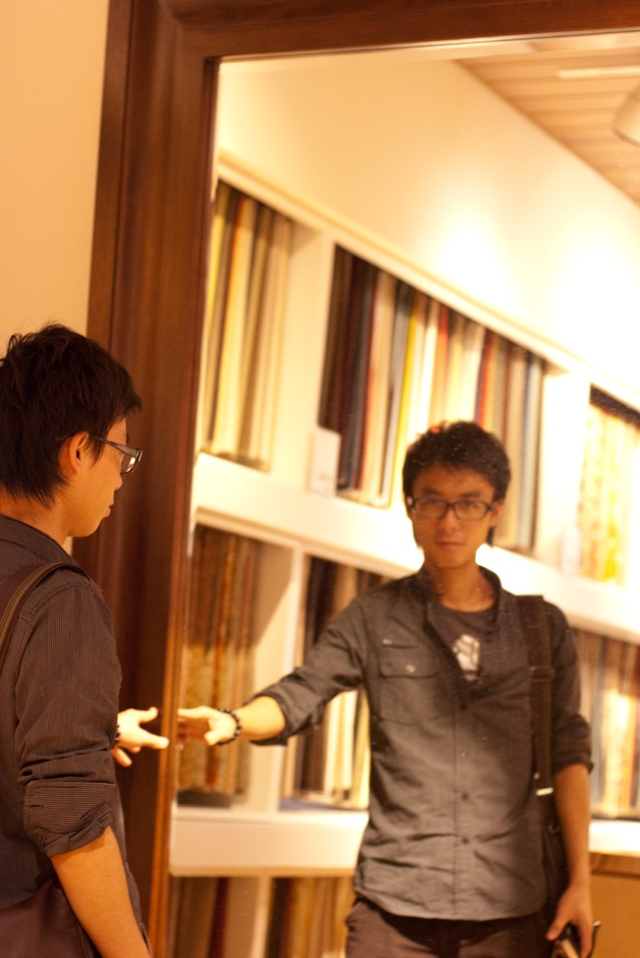
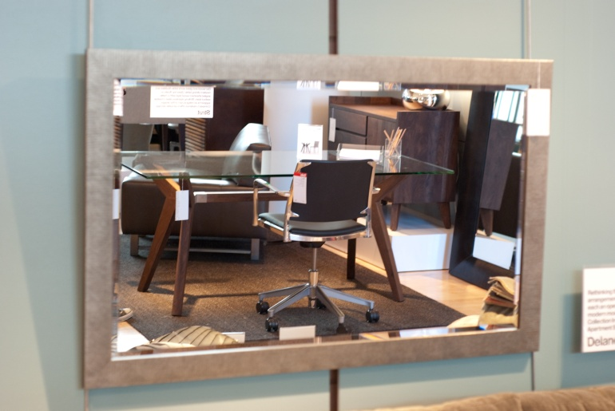
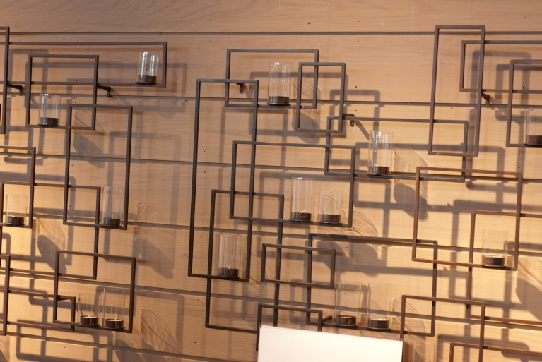
Research
Overview
Predispositions
Research
Insights
Concepts
Prototype
Strategies

Slide 7
Insights
Overview
Predispositions
Research
Insights
Concepts
Prototype
Strategies
Whereabouts of Children
Large Hand Gestures
Home Decor

Slide 8
Concepts
Overview
Predispositions
Research
Insights
Concepts
Prototype
Strategies
Tracking Devices
Family Photographs
People Locating Refrigerator
Drooping Flowers

Slide 9
Problem Core
Overview
Predispositions
Research
Insights
Concepts
Prototype
Strategies
Keeping Track of People

Slide 10
Mantra
Overview
Predispositions
Research
Insights
Concepts
Prototype
Strategies
Beneficial Awareness

Slide 11
Design Core
Overview
Predispositions
Research
Insights
Concepts
Prototype
Strategies
Large Gestures

Slide 12
Prototype
Overview
Predispositions
Research
Insights
Concepts
Prototype
Strategies

Slide 13
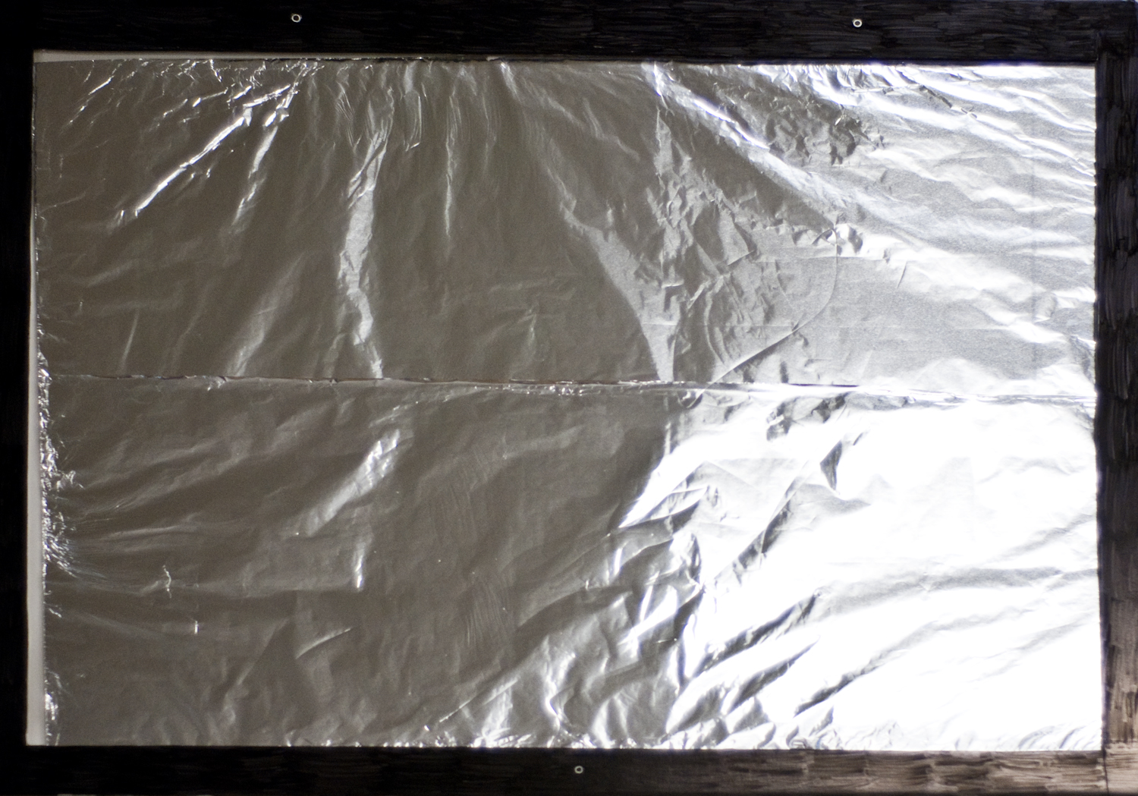
Overview
Predispositions
Research
Insights
Concepts
Prototype
Strategies

Slide 14
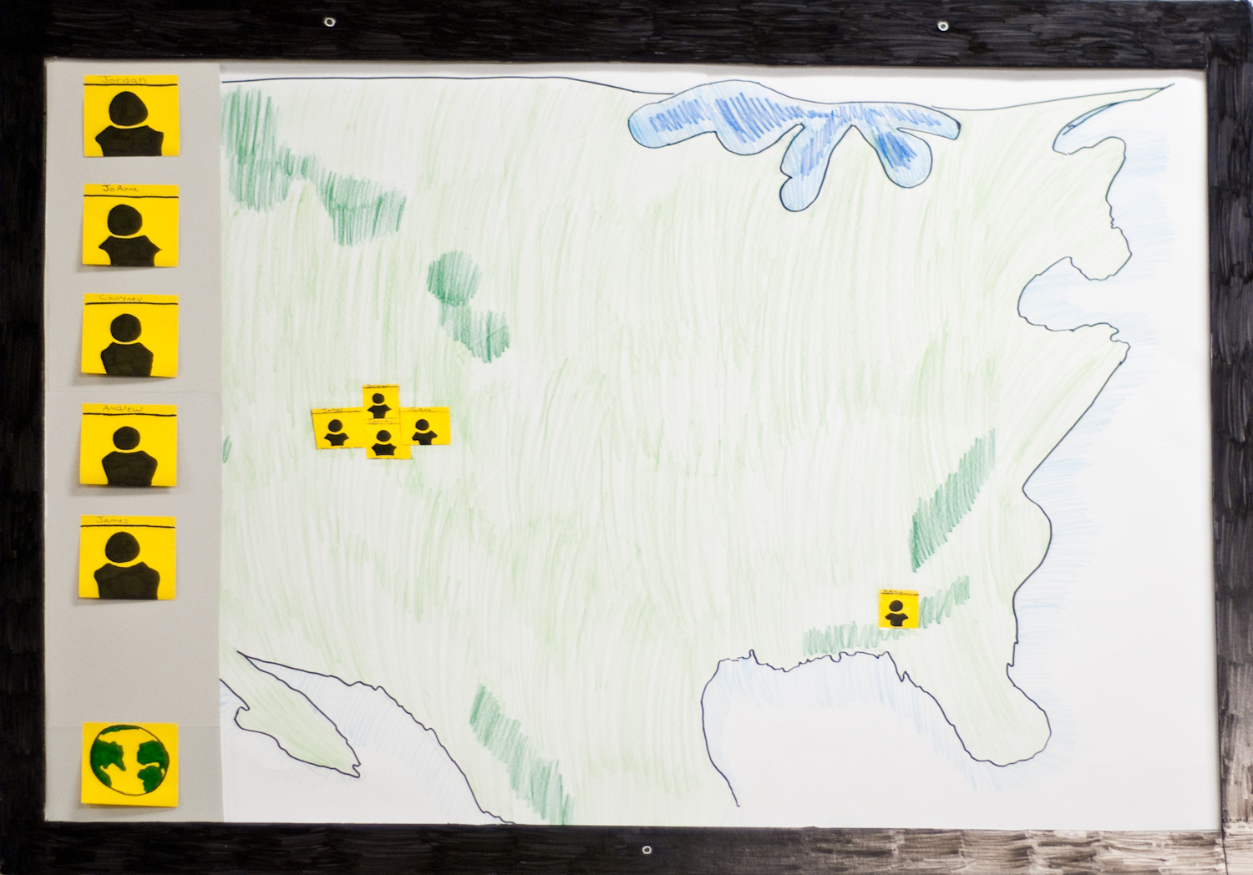
Overview
Predispositions
Research
Insights
Concepts
Prototype
Strategies

Slide 15
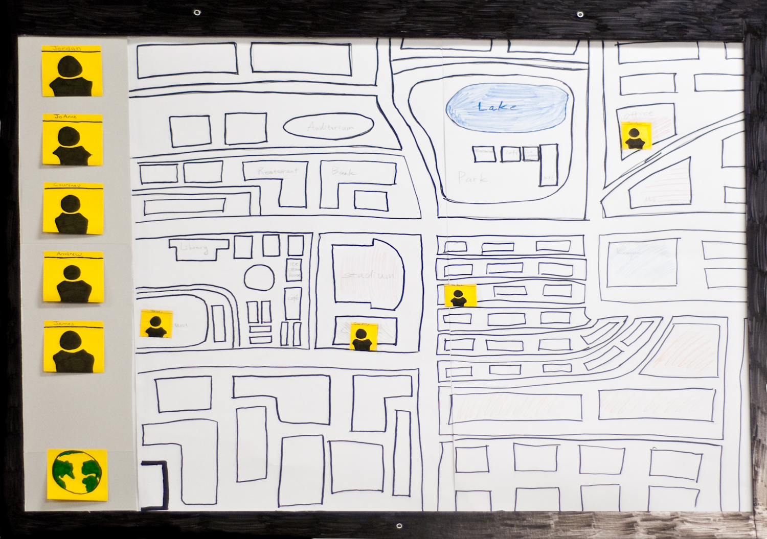
Overview
Predispositions
Research
Insights
Concepts
Prototype
Strategies

Slide 16
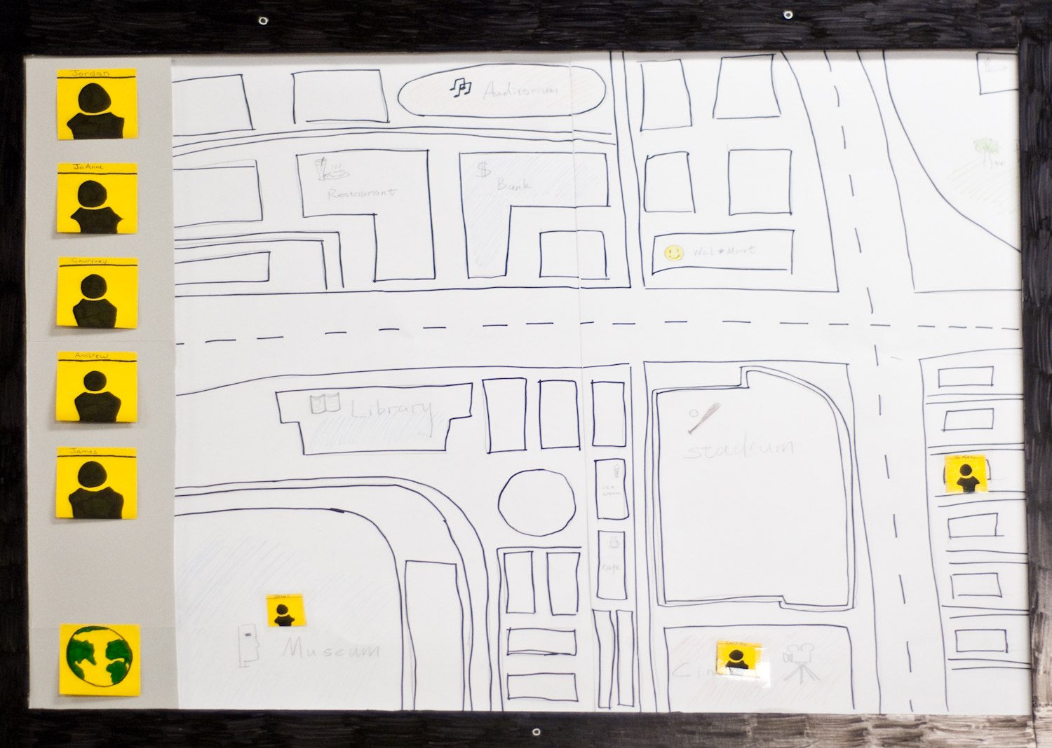
Overview
Predispositions
Research
Insights
Concepts
Prototype
Strategies

Slide 17
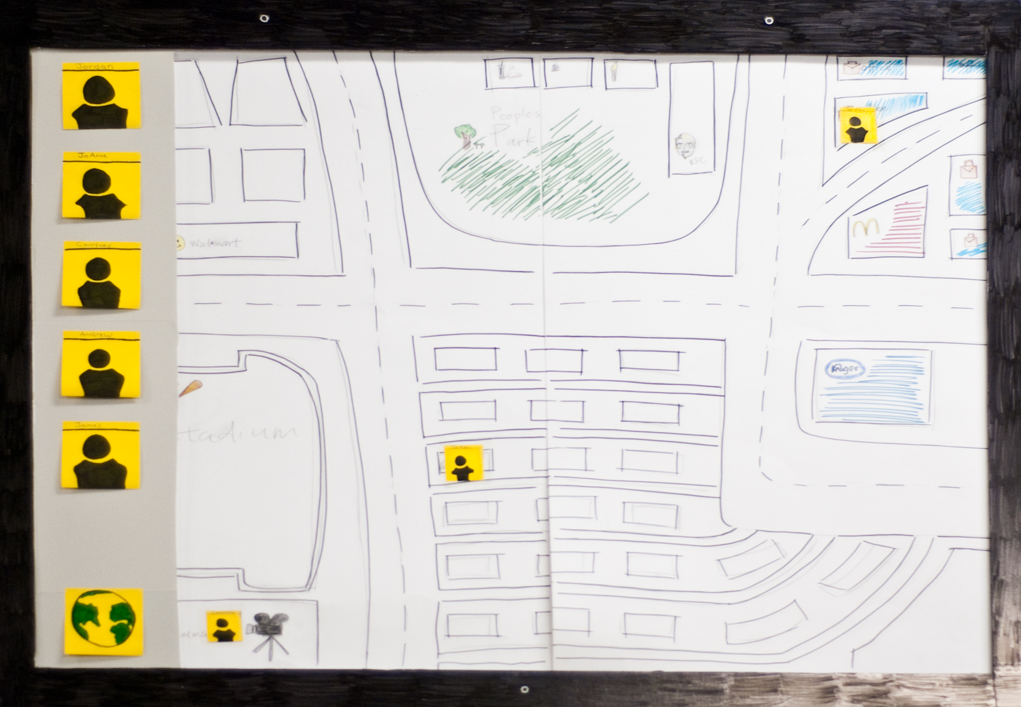
Overview
Predispositions
Research
Insights
Concepts
Prototype
Strategies

Slide 18
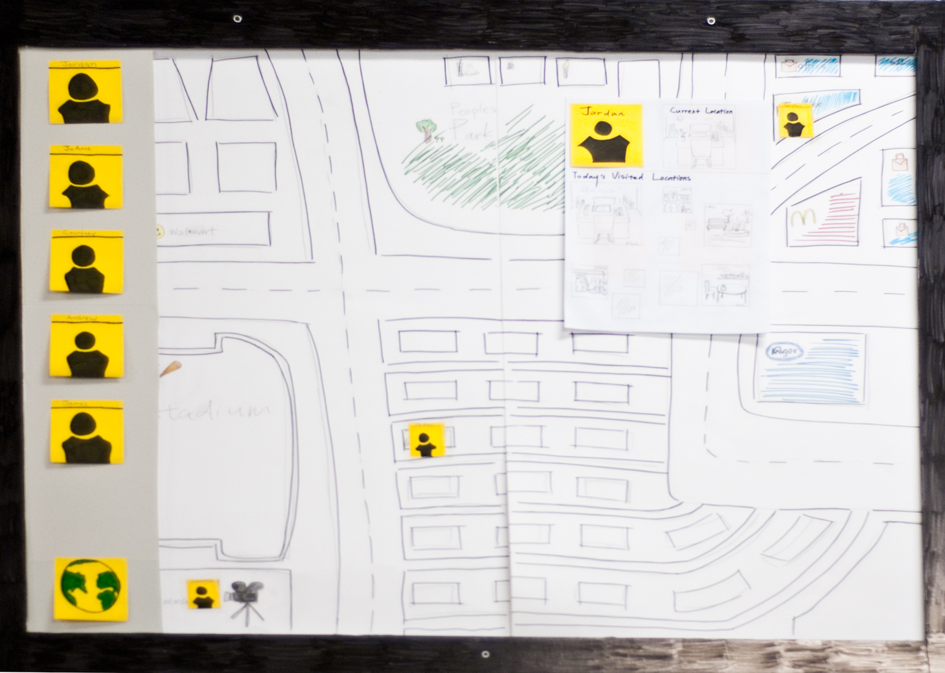
Overview
Predispositions
Research
Insights
Concepts
Prototype
Strategies

Slide 19
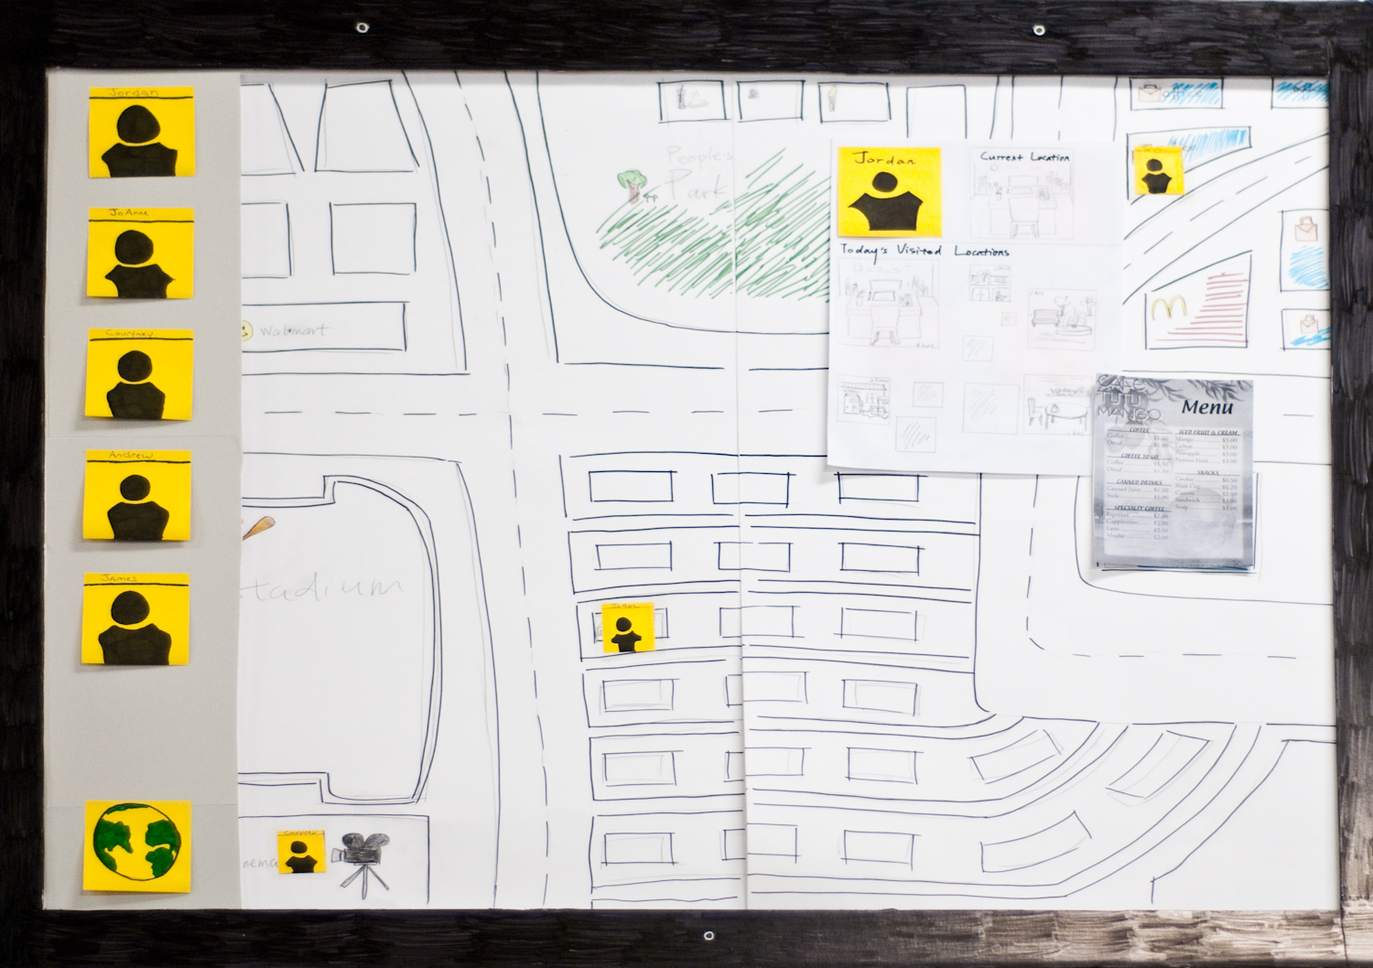
Overview
Predispositions
Research
Insights
Concepts
Prototype
Strategies

Slide 20
Overview
Predispositions
Research
Insights
Concepts
Prototype
Strategies

Slide 21
Strategies
Overview
Predispositions
Research
Insights
Concepts
Prototype
Strategies
Compact Mirror
Types of Tracking Devices
Future Features

Slide 22
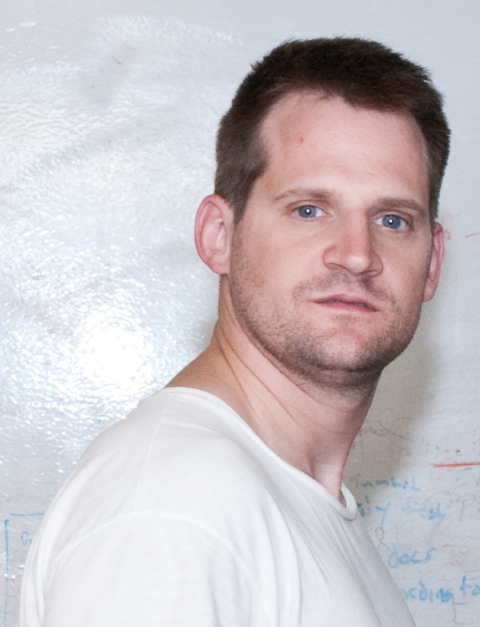
Thank You
Overview
Predispositions
Research
Insights
Concepts
Prototype
Strategies
Colby

Slide 23
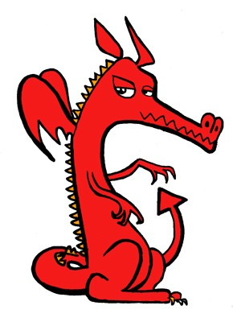
Thank You
Overview
Predispositions
Research
Insights
Concepts
Prototype
Strategies
Mentors
  Casey
  Xuan
Classmates
  KO
  Elisha
  Ravi

Slide 24
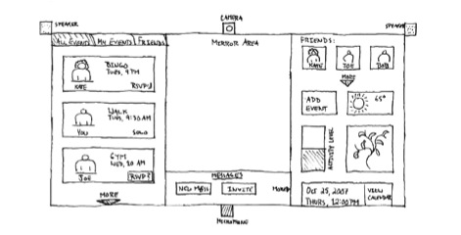
Mirror Motive
Overview
Predispositions
Research
Insights
Concepts
Prototype
Strategies
Engages elderly individuals in community events
Feedback via a onscreen plant
Persuading users to get involved by ‘peeking’ into community room
http://ethos.indiana.edu/?page_id=25 on 10/20/09

Slide 25
Project Natal
Overview
Predispositions
Research
Insights
Concepts
Prototype
Strategies
Controller free gaming
Use body as controller
“See a ball? Kick it, hit it, trap it or catch it.”

